Slide 1
VAAGDEVI COLLEGE OF ENGINEERING
NAME: T.MALLISHWARI
BRANCH:CSE(C)
ROLL NO:22641A05P3

Slide 2
AI TOOLS
Research rabbit
Trinka
Consensus
Chat pdf
Chat gpt.

Slide 3
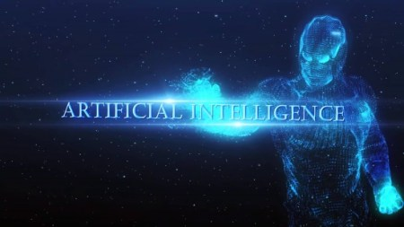
Introduction….
An enterprise AI platform is an integrated set of technologies that enables organisations to design,develop,deploy and operate enterprise AI applications at scale.
An AI tool is a software application that uses artificial intelligence algorithms to perform specific tasks and solve problems.
AI can help improve access to education,health care,and clean water,and can also aid in the fight against climate change,poverty,and hunger.
This Photo by Unknown Author is licensed under CC BY

Slide 4

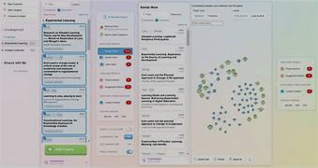
RESEARCH RABBIT
Fast tracks your entire literature review process.
Upload our research papers on a particular topic{seed papers}to create a collection of research papers.
Based on that it will recommend you more relevant research papers.
New rch papers too.
It helps you to more quicker and effective literature survey.
This tool is absolutely free.

Slide 5

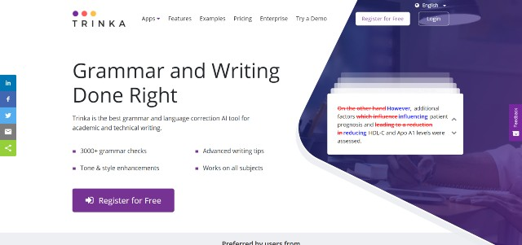
TRINKA…
Grammar or spelling correction Tool.
Designed specifically for Academic Writing.
Catch tricky mistakes in terms of technical writing and scientific writing.
Corrects your sentence structure,tone,language usage and style etc.

Slide 6

CONSENSUS…
It is a search engine.
It uses AI to extract data and then give you findings directly from scientific data.
When you ask Google a question, It will show you a lot of blogs,articles even sponsored adds written by marketing ads.
When the same question is asked to consensus it will gives you accurate answer and it is based on scientific evidence.
It is useful to know answer to questions you are confused about and understand topic completely.
This tool is absolutely free.

Slide 7
CHAT PDF….
Chat with the PDF and get your questions answered.
Similar to chat PDF.
If you ask a question it will search the entire pdf that you have uploaded and then try to answer it.
Useful when you are new to particular research field.
Summarize research papers in simple words
This tool is also absolutely free..

Slide 8
PROS AND CONS OF ARTIFICIAL INTELLIGENCE….
PROS OF AI….
Error-free Processing.
Helps in repetitive jobs.
24/7 availability.
Right Decision-making.
Digital assistance.
Faster decision making.
New inventions…
.

Slide 9
CONS OF AI….
High costs of Creation.
Increased Unemployment.
Lacking creativity.
Lacking Improvement.
No Human Replication.

Slide 10
THANK YOU…
NAME:: T.MALLISHWARI
ROLL NO:: 22641A05P3
BRANCH::CSE(c)…

